Slide 1
Introduction to Statistical Learning
Chapter 01 – Introduction
Lecturer: Dayong Tian
School of Electronics and Information

Slide 2
Statistical Learning, Machine Learning, Deep Learning, Artificial Intelligence
Artificial Intelligence
Machine Learning
Statistical Learning
Deep Learning

Slide 3
Preliminary
1. Probability theory
2. Linear algebra
3. Certainly, a CET-4 at least…
Biology
Medical Science
Social Science
Physics
Finance
Economics
Don’t be afraid of your vocabulary!
Don’t be afraid of your background knowledge!

Slide 4


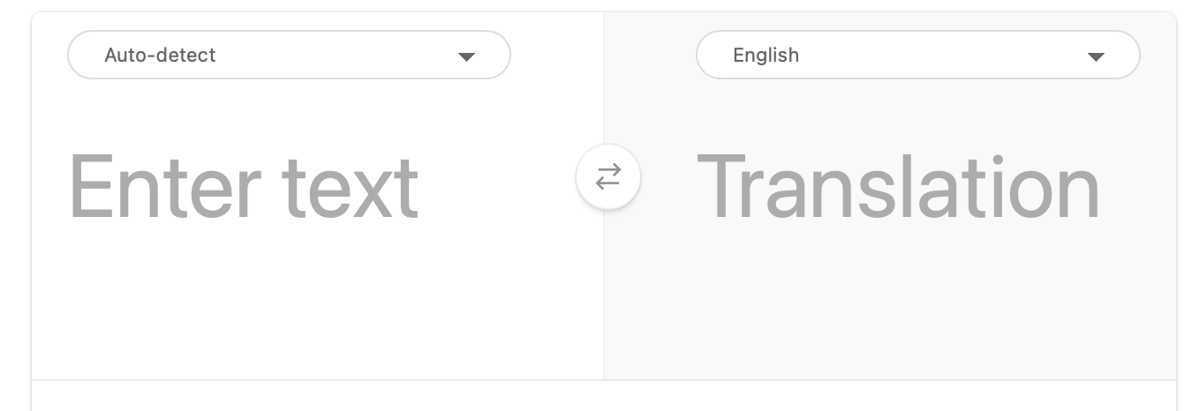
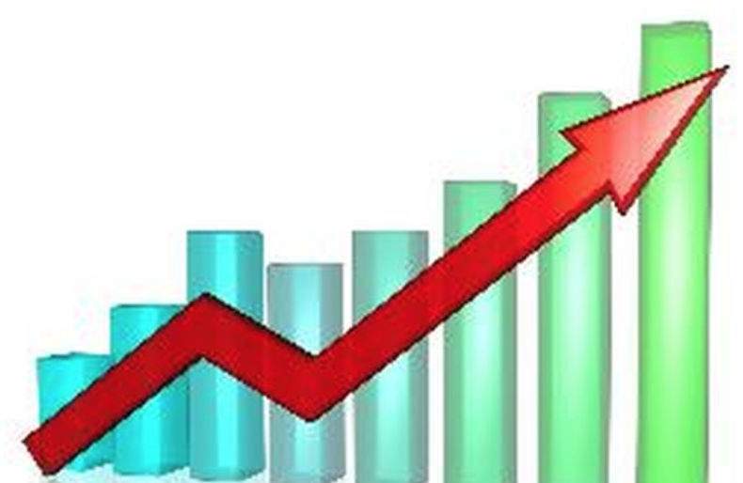
Applications of Machine Learning
Natural Language Processing
Computer Vision
Unmanned Vehicles
Data mining
Price prediction
Medical diagnosis
Play games
…

Slide 5
Natural Language Processing
Text Classification
Text Censoring
Machine Translation
Search Engine
Recommendation
Question and Answering
Conversation
Text Generation

Slide 6


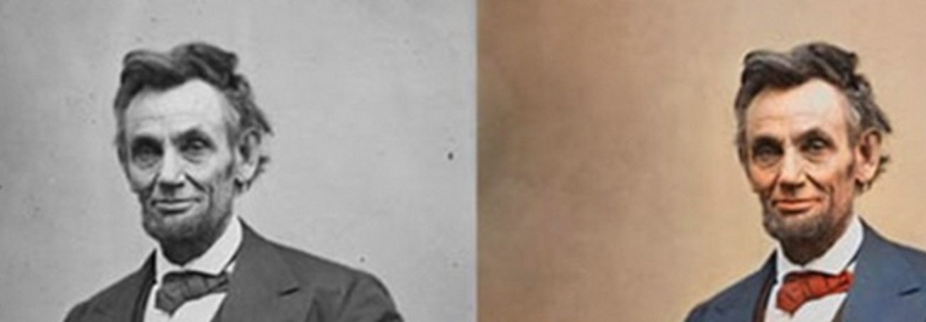
Computer Vision
Restoration
Colorization
Reconstruction
Super-resolution
Segmentation
Classification
Object Detection and Tracking
Camera-shaking blur
Out-of-focus blur
Colorization

Slide 7
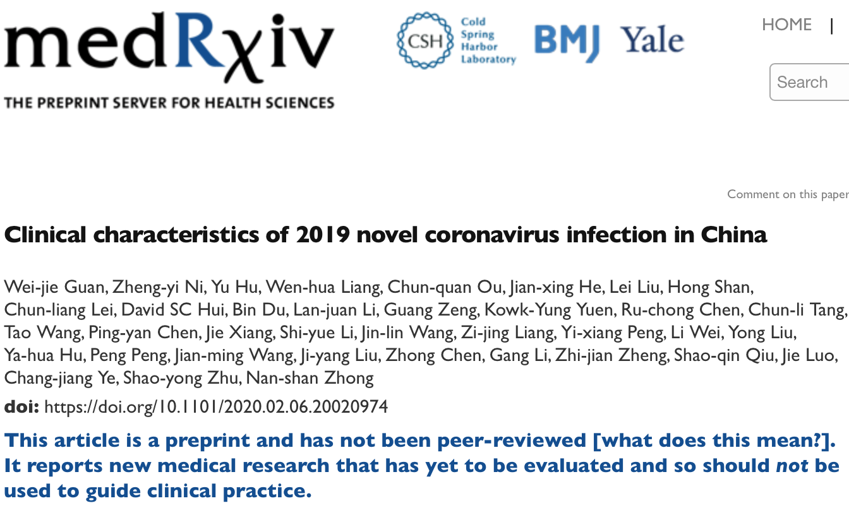
Why English?
1st generation: Ancient Greek
2nd generation: Latin
3rd generation: English
Acquire the latest innovation and researches.
Spread your ideas across the world.
Visit a vast database of knowledge.
Avoid misunderstanding generated by translation.
A hot topic in natural language processing.

Slide 8
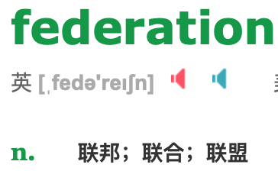
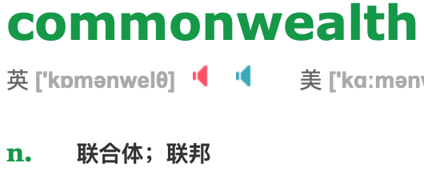
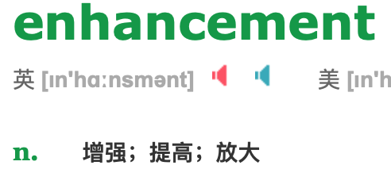
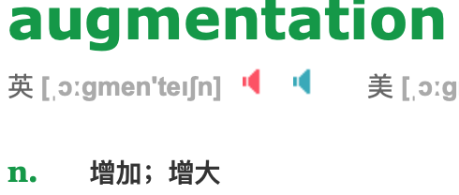
Misunderstanding from Translation
感冒Cold
流行性感冒Influenza
联邦Federation vs Commonwealth
数据增强(data enhancement)
数据增广(data augmentation)

Slide 9


Pros and cons of English
1. Reduce the communication barriers
2. Easy to encode
3. Word Segmentation
Subtitle: Charge Mr. Huen 30 Liang (unit) silver as rent. Subletting is strictly forbidden.
Subtitle: Charge Mr. Huen 300,000 Liang (unit) silver as rent. Subletting is forbidden.

Slide 10
Pros and cons of English
1. Similar meaning but dissimilar words.
2. Spelling and Pronunciation are not corresponding.
3. Low entropy.
Some Latin words
Latin (short) | Latin (full) | English | Chinese
etc. | et cetera | and so on | 等
i.e. | id est | that is | 即
e.g. | exempli gratia | For example | 例如

Slide 11


What Is the Relation Between Statistics And Learning?
Let’s say we have an uneven coin. We want to build a model to predict the result of tossing it.
Subtitle: Use the Earth’s gravity as well as other astronomical bodies

Slide 12
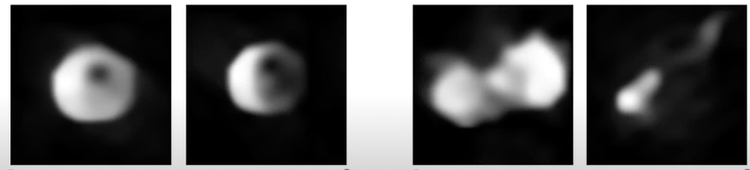
An Overview of Statistical Learning
Statistical learning refers to a vast set of tools for understanding data. It builds a model to connect inputs and outputs.
Synthetic Aperture as large as the Earth’s diameter
Search Katie Bouman on
TED
output
Regularized Maximum Likelihood Estimation
input

Slide 13

An Overview of Statistical Learning
These tools can be classified as supervised or unsupervised, semi-supervised, etc.
Whether do we have labeled data or not.
Exp 1. Image Segmentation and object detection

Slide 14
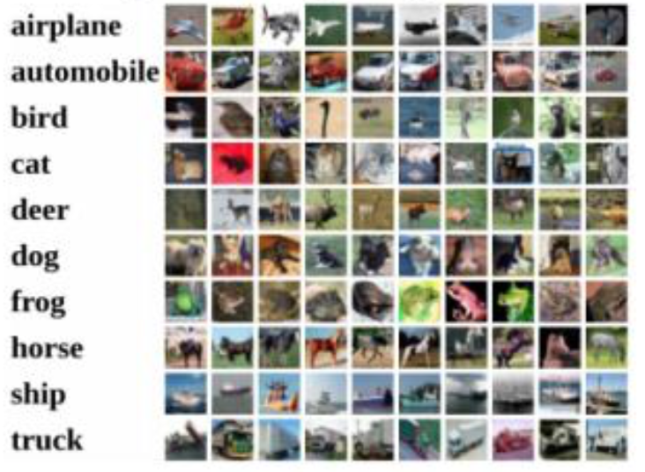
Exp 2. Regression
Exp 3. Classification VS Clustering

Slide 15

Reinforcement Learning
Reinforcement learning tries to train an agent to achieve high rewards in a given environment.
How can we train an unmanned space ship to travel across the galaxy?

Slide 16
Exercise 1. Categorize the following learning tasks.
1. AlphaGo was trained by millions of human-played games. Each data item consists of a sequence of actions of two players and a notation of who won the game.
2. AlphaGo Zero generated tens of millions of games by itself. Researchers only gave it a role to judge the winner.
3. Tencent Juewu AI generates millions of games by itself and beat the top 0.01% players of Honor of Kings in 1v1 situation.
4. Face identification system installed in students’ apartments.
5. Google translate.

Slide 17
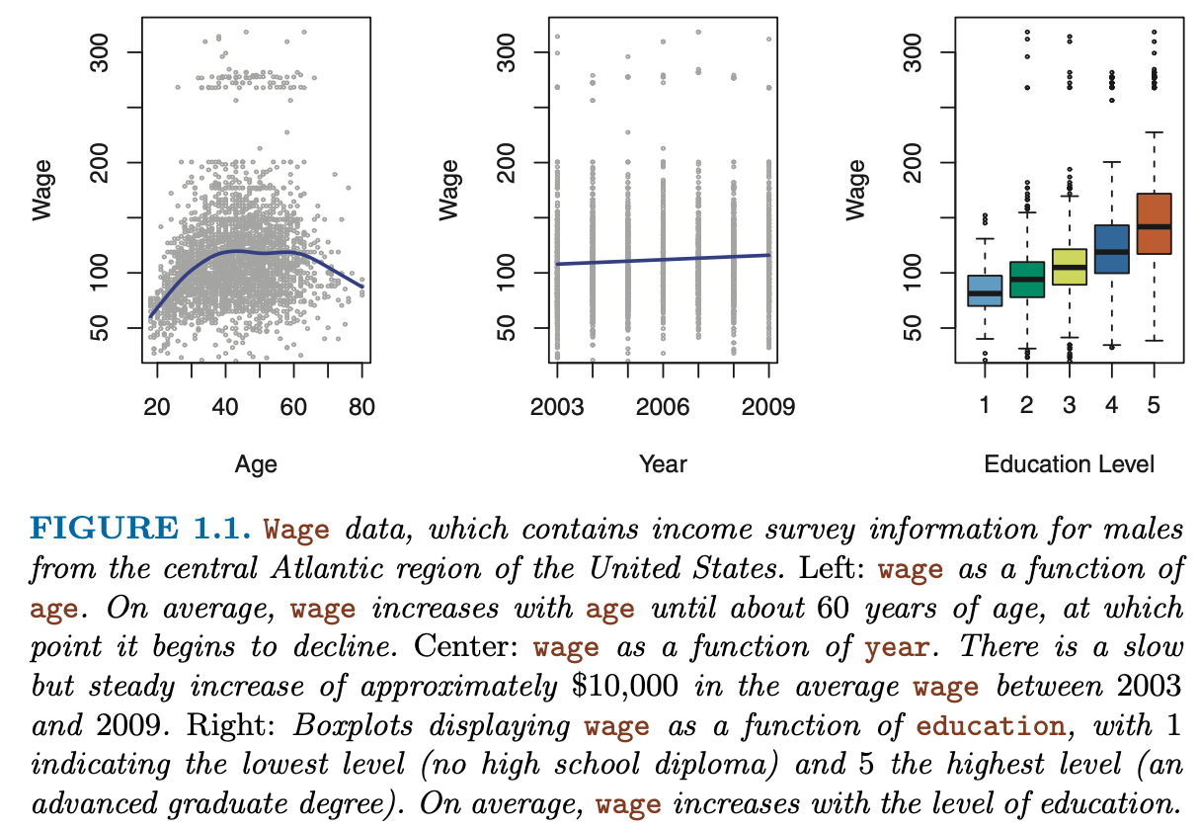
Data Used in This Course
1. Wage Data

Slide 18
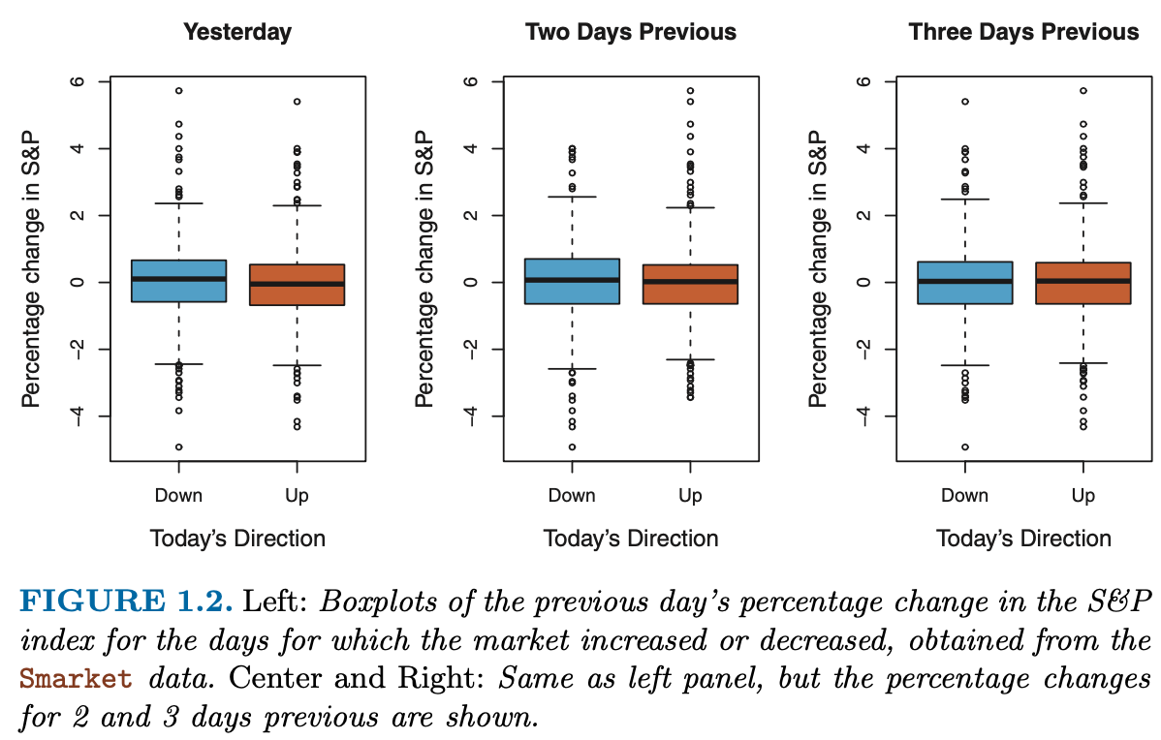
2. Stock Market Data

Slide 19
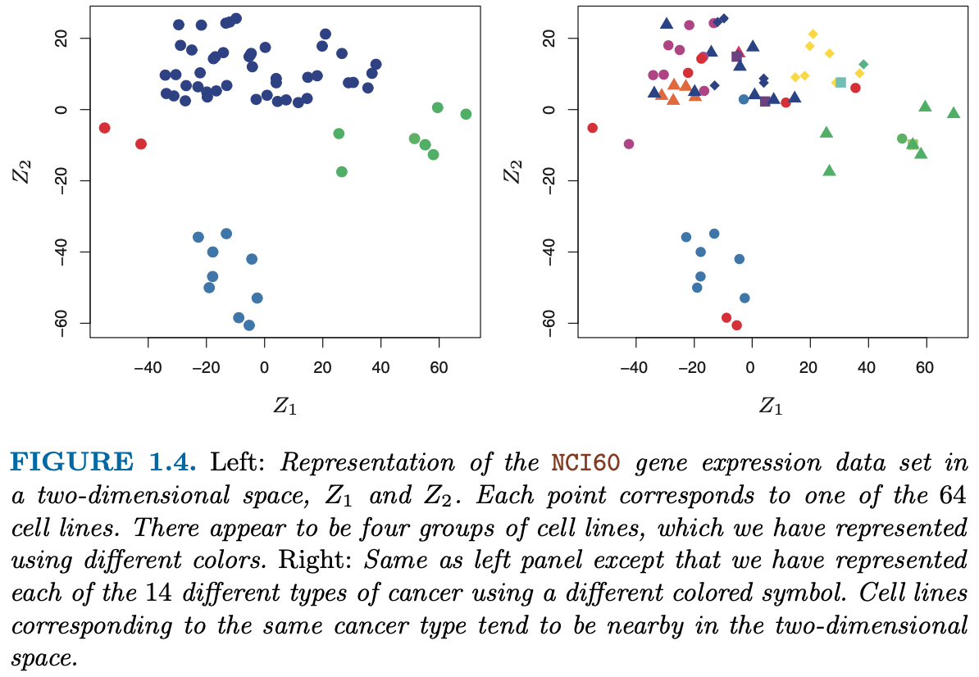
3. Gene Expression Data

Slide 20
Syllabus of This Course
Evaluation
Attendance | 10%
Homework | 20%
Final Exam | 70%
Homework
Homework consists of a few theoretical quizzes and programming tasks.
Notes:
All homework and final exam should be written in English.
Attending classes is not firmly required, but homework should be submitted before each deadline.

Slide 21
Materials:
QQ Group Chat: 738453207
R: https://mirrors.tuna.tsinghua.edu.cn/CRAN/
Rstudio, Textbook and Data:
Link: https://pan.baidu.com/s/1USQaWagPQlOdrQzxmYjsEg
Password: i5im

Slide 22
Variable and Observation
Action Variable Vector X: (shopping, moving, skills) , a row vector
Observations: shopping can be any item can be purchased. Items can be represented by 1,2,3,4,…
moving can be one of 9 directions which can be represented by 1,2,3,…,9.
skills can be any of the 6 buttons which can be represented by 1,2,….,6

Slide 23
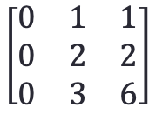
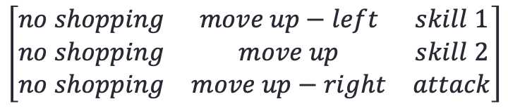
Frame 1
$$\left[\begin{matrix}0 & 1 & 1 \\ 0 & 2 & 2 \\ 0 & 3 & 6\end{matrix}\right]$$
$$\left[\begin{matrix}no shopping & move up−left & skill 1 \\ no shopping & move up & skill 2 \\ no shopping & move up−right & attack\end{matrix}\right]$$
Frame 2
Frame 3

Slide 24
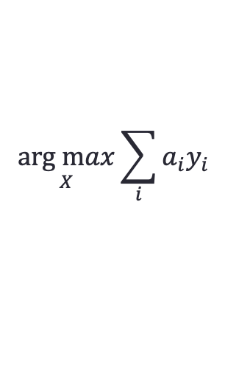
Reward Variable Vector Y: (money, health point of hero, health point of turrets and bases,
the rate of mana, being killed, experience)
(79+79, 1750, 0, -300, 0, 50)
(2, 1, 1.5, 0.2, 2, 0.5)
$$\underset{X}{arg max}{\sum_{i}{{a_{i}y}_{i}}}$$

Slide 25
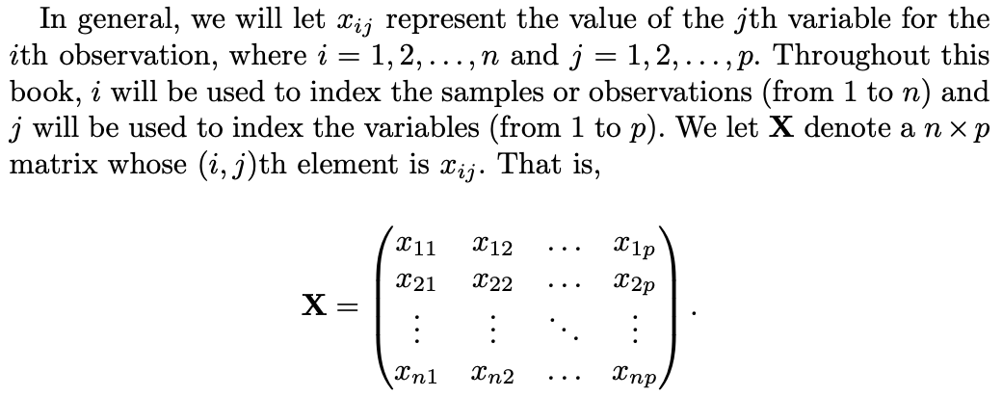
Notation and Simple Matrix Algebra

Slide 26
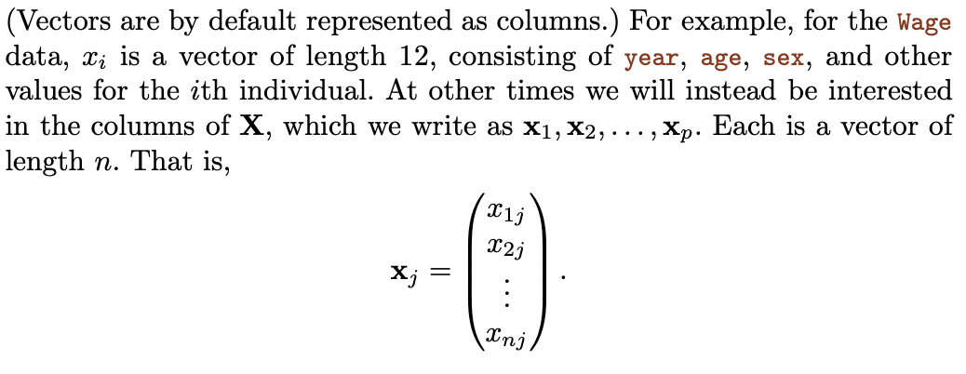
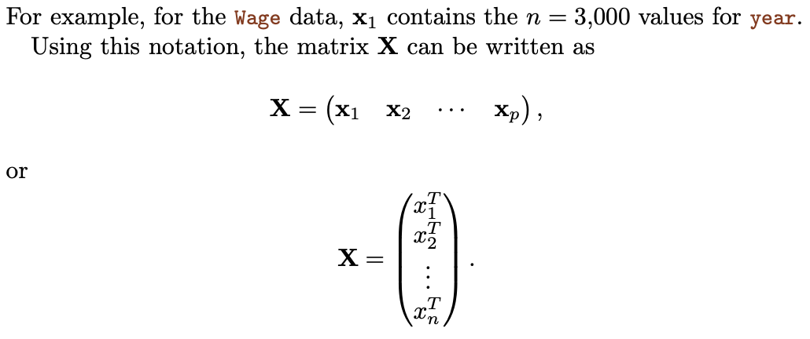

Slide 27
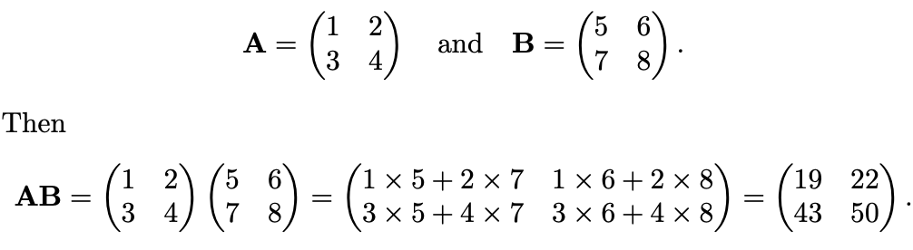
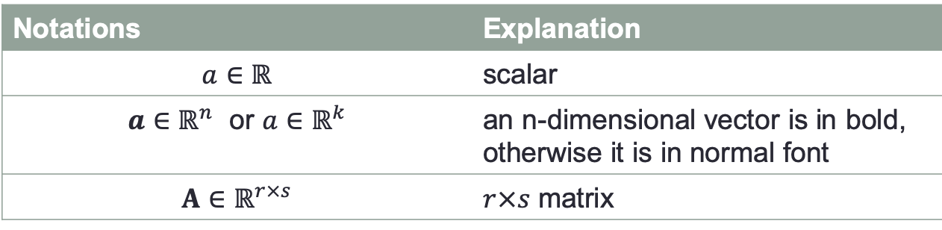
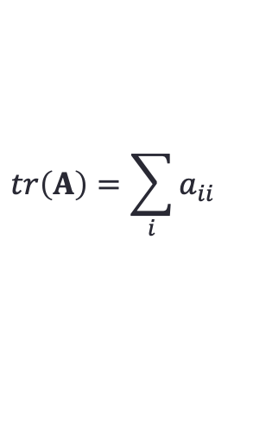
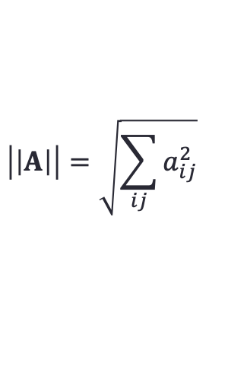
Matrix is denoted using bold capitals, such as A. Random variables are denoted using capital normal font, such as A, regardless of their dimensions.
Notations | Explanation
$$a∈ℝ$$ | scalar
$a∈ℝ^{n}$ or $a∈ℝ^{k}$ | an n-dimensional vector is in bold, otherwise it is in normal font
$$A∈ℝ^{r×s}$$ | $r×s$ matrix
$$\left|\left|A\right|\right|=\sqrt{\sum_{ij}{a_{ij}^{2}}}$$
$$tr\left(A\right)=\sum_{i}{a_{ii}}$$
Norm
Trace

Slide 28
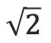
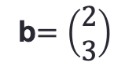
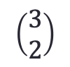
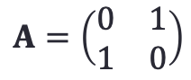
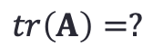
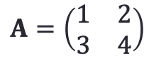

Exercise 2. Matrix Algebra
$$A=\left(\begin{matrix}0 & 1 \\ 1 & 0\end{matrix}\right)$$
b$=\left(\begin{matrix}2 \\ 3\end{matrix}\right)$
$$\left(\begin{matrix}3 \\ 2\end{matrix}\right)$$
1.
Ab=?
2.
$$A=\left(\begin{matrix}0 & 1 \\ 1 & 0\end{matrix}\right)$$
||A||=?
$$\sqrt{2}$$
3.
$$A=\left(\begin{matrix}1 & 2 \\ 3 & 4\end{matrix}\right)$$
$$tr\left(A\right)=?$$
5
4. If we want to predict the stock price of a company, what are the variables and observations?
An example: (profit, price/earning ratio, news), (100,000,000, 20, -1)

Slide 29

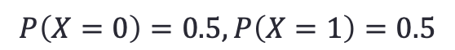
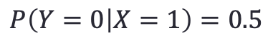
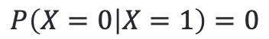
Review of Probability Theory
Random Variable
A random variable is itself a function of the result of a statistical experiment in which each outcome has a definite probability of occurrence.
0
1
We will define a random variable X to denote the outcome of the experiments.
$$P\left(X=0\right)=0.5,P\left(X=1\right)=0.5$$
Conditional probability
$$P\left(X=0 | X=1\right)=0$$
If we toss two coins
$$P\left(Y=0 | X=1\right)=0.5$$
Bayes’ Equation: $P\left(Y | X\right)P\left(X\right)=P\left(X | Y\right)P\left(Y\right)=P(X,Y)$

Slide 30
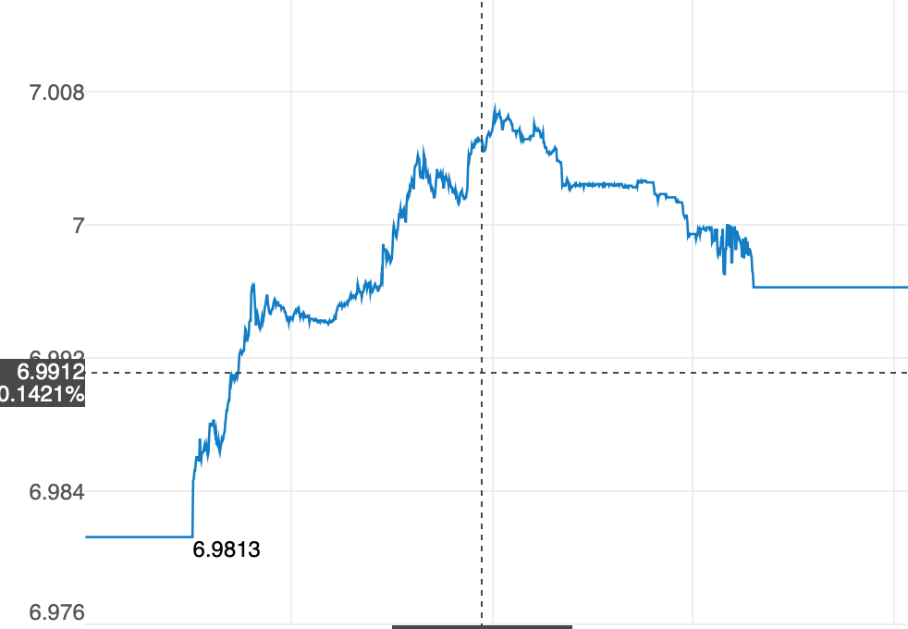
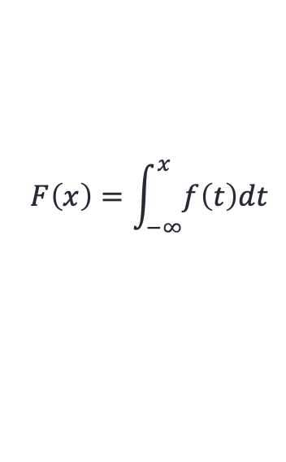
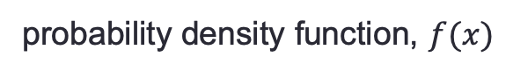
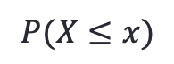
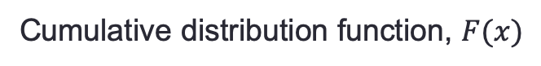
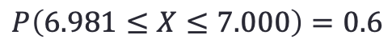
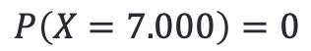
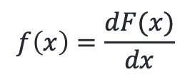
2. Probability density function
Random variables can be continuous. We use probability density function and cumulative distribution function to describe continuous random variables.
USD vs CNY exchange rate.
Source: Sina Finance
6.981
7.008
6.981
7.008
probability density function, $f(x)$
Cumulative distribution function, $F(x)$
$$P\left(X=7.000\right)=0$$
$$P(X≤x)$$
$$P\left(6.981≤X≤7.000\right)=0.6$$
$$F\left(x\right)=\int_{−∞}^{x}{f\left(t\right)dt}$$
$$f\left(x\right)=\frac{dF(x)}{dx}$$

Slide 31
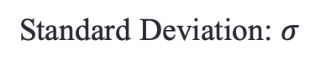
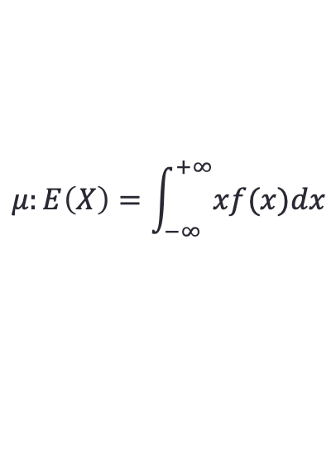
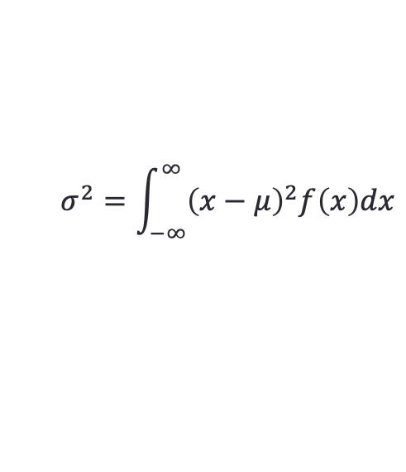
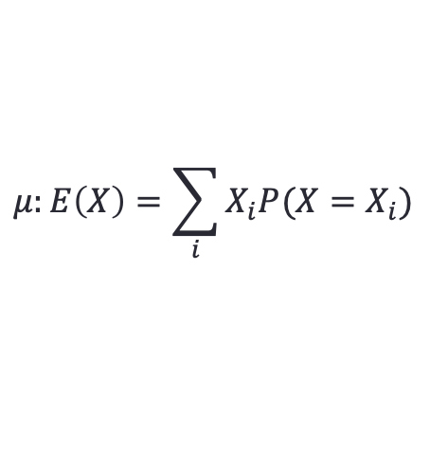
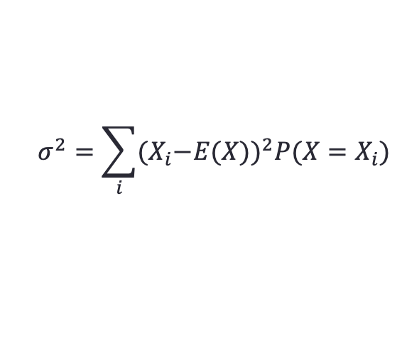
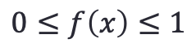
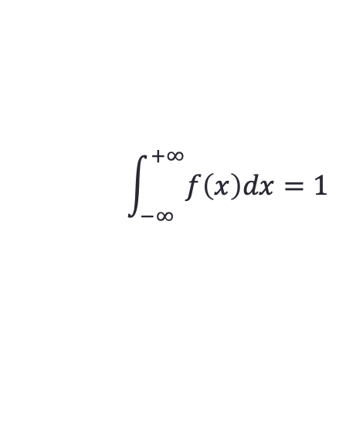
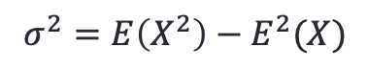
3. Properties of probability density function
$$\int_{−∞}^{+∞}{f\left(x\right)dx=1}$$
$$0≤f\left(x\right)≤1$$
4. Mean
$$μ:E\left(X\right)=\sum_{i}{X_{i}P(X=X_{i})}$$
$$μ:E\left(X\right)=\int_{−∞}^{+∞}{xf(x)dx}$$
5. Variance & Standard Deviation
$$σ^{2}=\sum_{i}{{{(X}_{i}−E(X))}^{2}P(X=X_{i})}$$
Variance
Standard Deviation: $σ$
$$σ^{2}=\int_{−∞}^{∞}{{\left(x−μ\right)}^{2}f\left(x\right)dx}$$
$$σ^{2}=E\left(X^{2}\right)−E^{2}(X)$$

Slide 32
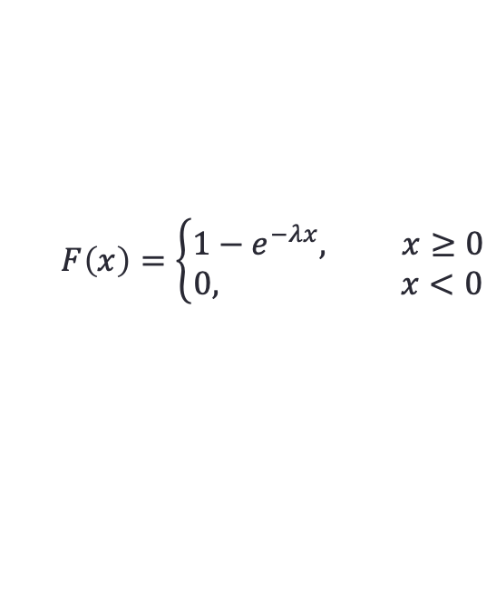
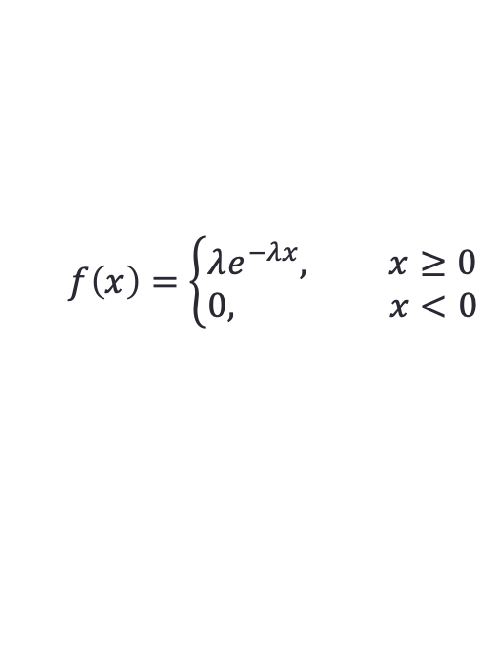
Exercise 3. Probability Theory
1. Calculate the mean and variance of X
X=0 | X=1 | X=2
0.3 | 0.4 | 0.3
Mean: 1, Variance: 0.6
2. Calculate the probability density function of the following cumulative distribution function ($λ$ is a constant):
$$F\left(x\right)=\left\{\begin{matrix}1−e^{−λx}, x≥0 \\ 0, x<0\end{matrix}\right.$$
3. Calculate the cumulative distribution function of the following probability density function
$$f\left(x\right)=\left\{\begin{aligned}λe^{−λx}, x≥0 \\ 0, x<0\end{aligned}\right.$$
4. Calculate the mean and variance of the probability density function in 3.

Slide 33



Some Widely-Used Distributions
1. Binomial Distribution or Bernoulli Distribution
$$P\left(X=k\right)=C_{n}^{k}p^{k}{\left(1−p\right)}^{n−k}$$
The probability of outputting k successes by repeating experiments n times independently.
Toss a coin 5 times. What is the probability of 4 heads?
$$P\left(X=4\right)=C_{5}^{4}{0.5}^{4}×0.5≃0.156$$
Toss a dice 3 times. What is the probability that all are 1?
$$P\left(X=3\right)=C_{3}^{3}{\left(\frac{1}{6}\right)}^{3}≃0.0046$$

Slide 34






2. Poisson Distribution
$$P\left(X=k\right)=\frac{λ^{k}}{k!}e^{−λ}$$
Exercise (optional): Prove
$$μ=σ^{2}=λ$$
The probability of the number of successes when the probability of success, p is small$.$
Toss a dice 100 times and the probability of getting 1 five times is ${C_{100}^{5}\left(\frac{1}{6}\right)}^{5}{\left(\frac{5}{6}\right)}^{95}≃$0.00029 and $\frac{{\left(100×\frac{1}{6}\right)}^{5}}{5!}e^{−100×\frac{1}{6}}≃0.0006.$
Extract a card from 54 poker cards 100 times, what is the probability of getting red joker 5 times?
$$C_{100}^{5}{\left(\frac{1}{54}\right)}^{5}{\left(\frac{53}{54}\right)}^{95}≃0.02776$$
$$\frac{{\left(100×\frac{1}{54}\right)}^{5}}{5!}e^{−100×\frac{1}{54}}≃0.02848$$
$$λ=np$$

Slide 35



3. Exponential Distribution
$$μ=\frac{1}{λ}, σ^{2}=\frac{1}{λ^{2}}$$
The exponential distribution (also called the negative exponential distribution) is a probability distribution that describes time between events in a Poisson process.
Suppose we extract a card from 54 poker cards 100 times every 1 unit time (say, 1 hour) and we want the red joker. What is the probability that the period between two successes is smaller than 0.5 unit time?
$$1−e^{−\frac{54}{100}×0.5}≃0.2366$$

Slide 36


The difference of $λ$ in Poisson distribution and Exponential distribution.
In the poker card experiments. $λ=np$ in Poisson distribution and $λ=1/np$ in Exponential distribution.
Distribution | $$λ$$
Poisson | The expected times of successes.
Exponential | The expected time between two successes.

Slide 37


3. Uniform Distribution
$$f\left(x\right)=\left\{\begin{aligned}\frac{1}{b−a}, a<x<b \\ 0, else\end{aligned}\right.$$
Exercise: Prove $μ=\frac{a+b}{2},σ=\frac{{\left(b−a\right)}^{2}}{12}$

Slide 38





4. Normal Distribution or Gaussian Distribution
$$f\left(x\right)=\frac{1}{\sqrt{2π}σ}e^{(−\frac{{\left(x−μ\right)}^{2}}{2σ^{2}})}$$
Exercise (optional): Prove $μ=μ,σ=σ$
Standard Normal Distribution: $μ=0,σ=1$
$$X\sim N\left(μ,σ\right), \frac{X−μ}{σ}\sim N(0,1)$$

Slide 39
What you will learn in this course?
1. Supervised learning methods, linear regression, polynomial regression, classification, k-nearest neighbors, linear discriminant analysis, support vector machine, tree-based methods, etc.
2. Unsupervised learning methods, hierarchical clustering, k-means clustering, dimension reduction.
3. Model accuracy assessment methods
4. Resampling methods
5. Some classical deep neural networks, including auto-encoder, convolutional neural network, variational auto-encoder, generative adversarial network, recurrent neural network, etc.

